Slide 1
K means Clustering

Slide 2
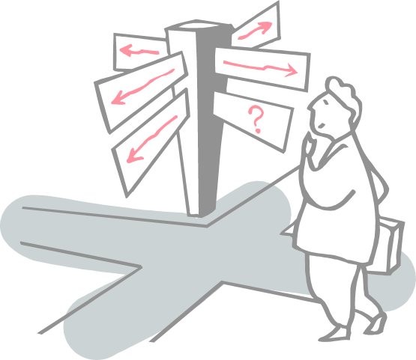
Roadmap
What is k means Clustering??
Numerical Example

Slide 3
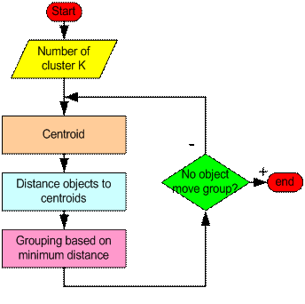
K means Algorithm

Slide 4
Example - 1
Consider the following data set consisting of the scores of two variables on each of seven individuals

Slide 5
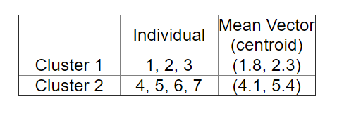
Example 1
Two clusters at this stage having the following characteristics

Slide 6
Example 1
Cannot yet be sure that each individual has been assigned to the right cluster.
So, compare each individual’s distance to its own cluster mean and to that of the opposite cluster.

Slide 7
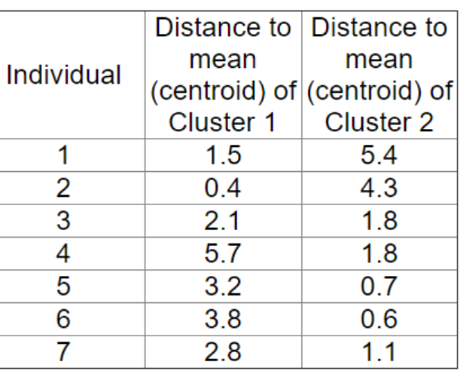
Example 1
Only individual 3 is nearer to the mean of the opposite cluster (Cluster 2) than its own (Cluster 1).
In other words, each individual's distance to its own cluster mean should be smaller that the distance to the other cluster's mean (which is not the case with individual 3)
The individual 3 is relocated to Cluster 2 resulting in the new partition
The iterative relocation would now continue from this new partition until no more relocations occur

Slide 8
Example – 2

Slide 9
Example 2- Solution

Slide 10
References
https://towardsdatascience.com/clustering-using-k-means-algorithm-81da00f156f6
http://mnemstudio.org/clustering-k-means-example-1.htm
https://people.revoledu.com/kardi/tutorial/kMean/NumericalExample.htm
http://dni-institute.in/blogs/k-means-clustering-algorithm-explained/

Slide 11
Thanks

